Slide 1




Color Stack Challenge

Slide 2

CONTENT
Introduction
Project Objectives
Key Features & Highlights
Technologies Used
Game Mechanics
ADSA Concepts Implemented
Conclusion

Slide 3
INTRODUCTION
In recent years, the development of simple yet engaging 2D games has gained popularity due to their ease of implementation and entertainment value. This project, titled "Color Stack Challenge", is a casual arcade-style game developed using Python and the Pygame library. It focuses on testing the player's timing and precision by requiring them to stack moving blocks as accurately as possible. With each successful placement, the player’s score increases, and the challenge intensifies as the stack grows taller. This project serves both as a learning experience for understanding game mechanics and as a foundation for building more complex games in the future. It is an excellent example of how a basic concept can be turned into an engaging gameplay experience using Python and Pygame.

Slide 4
PROJECT OBJECTIVE
Make a fun and easy block-stacking game using Python and Pygame.
Learn how games work by adding movement, player controls, and a scoring system.
Practice coding using object-oriented programming (OOP).
Boost your thinking, creativity, and problem-solving skills through game development.

Slide 5
HIGHLIGHTS OF THE PROJECT
Fun Gameplay: Stack blocks with perfect timing.
Colorful Design: Bright, random-colored blocks make it lively.
Skill-Based: Align blocks accurately to keep going.
Quick Controls: Press SPACE to drop blocks instantly.
Score System: Get points for each good stack, shown on screen.
Game Over Logic: Game ends if blocks don’t line up well.
Auto Restart: Game starts again after it ends—no need to click.
Organized Code: Uses OOP with a Block class for clean structure.
Great for Learning: Teaches Pygame basics like loops, input, and drawing.

Slide 6
Scope of the Project
This project is a beginner-friendly 2D game, ideal for learning the basics of Pygame and game development.
It’s easy to play using just one key (SPACE), making it accessible for everyone.
The game helps build a strong foundation for creating more advanced games in the future.
It can be expanded with extra features like high score tracking, power-ups, background music, and different difficulty levels.

Slide 7
DESIGN HIGHLIGHTS
• Follows Object-Oriented Programming for better structure
• Uses a single class (Block) for handling game objects
• Separates logic (movement, stacking) from display (drawing blocks)
• Easily scalable — new features like sound, animations, or levels can be added later

Slide 8
WHAT YOU WILL LEARN
• How to make a simple game with Python
• How to move and drop blocks
• How to take keyboard input (SPACE key)
• How to show score on the screen
• How to end the game when rules are broken
• How to restart the game automatically
• How to use colors and animations
• How to write clean code using classes

Slide 9
MODULES USED IN THE PROJECT
pygame
random
Function Notes – Color Stack Challenge
game_loop()
Block.__init__(self, x, y, color)
Block.move(self)
Block.draw(self)

Slide 10
pygame.init()
pygame.display.set_mode((WIDTH, HEIGHT))
pygame.display.set_caption("Color Stack Challenge")
pygame.KEYDOWN + pygame.K_SPACE
screen.fill(WHITE)
pygame.draw.rect(screen, color, (x, y, width, height))
font.render(text, True, color)
screen.blit(text, position)
pygame.display.update()
pygame.quit()

Slide 11
EXPLANATION
The Colour Stack Challenge is a simple arcade-style game built using Python and Pygame. The game creates a window where colourful blocks move side to side across the screen. The player controls when to drop the block by pressing the SPACE key. If the block lands correctly on top of the previous one, it gets added to the stack and the player earns points. If it doesn’t align properly, the game ends and shows a “Game Over” message. This project helps understand how games work behind the scenes and gives hands-on experience with animations, object-oriented programming, and real time interaction in Python.

Slide 12
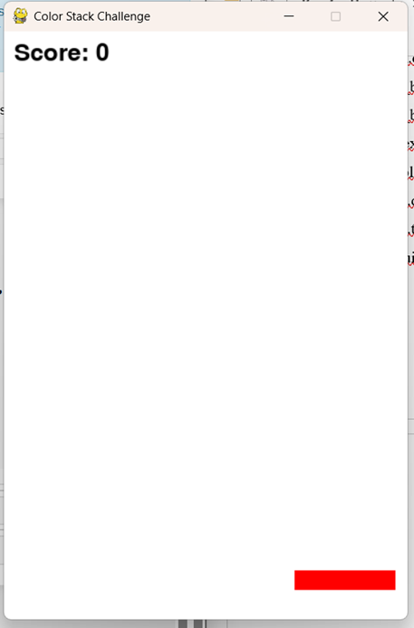
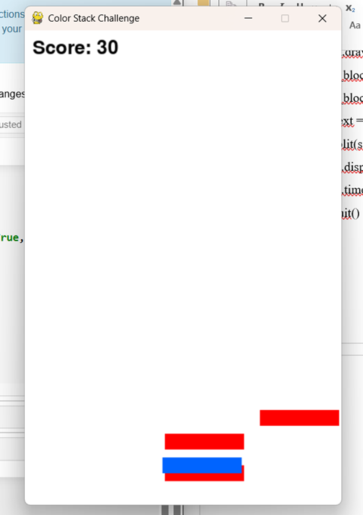

Slide 13
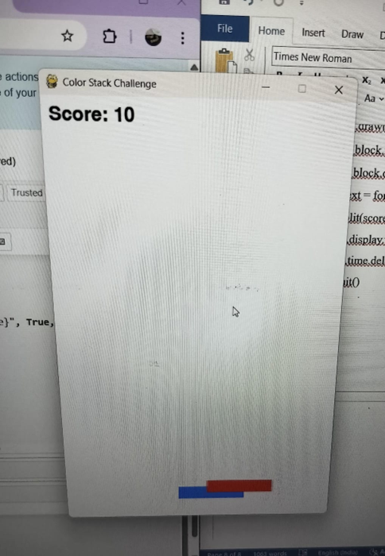
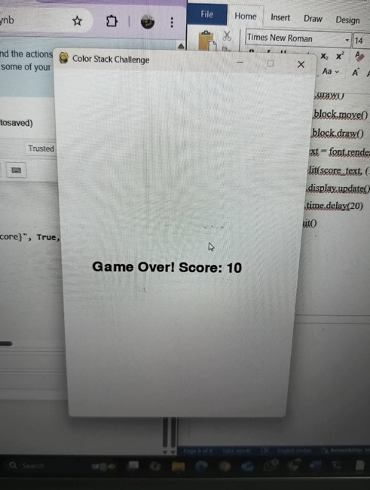

Slide 14
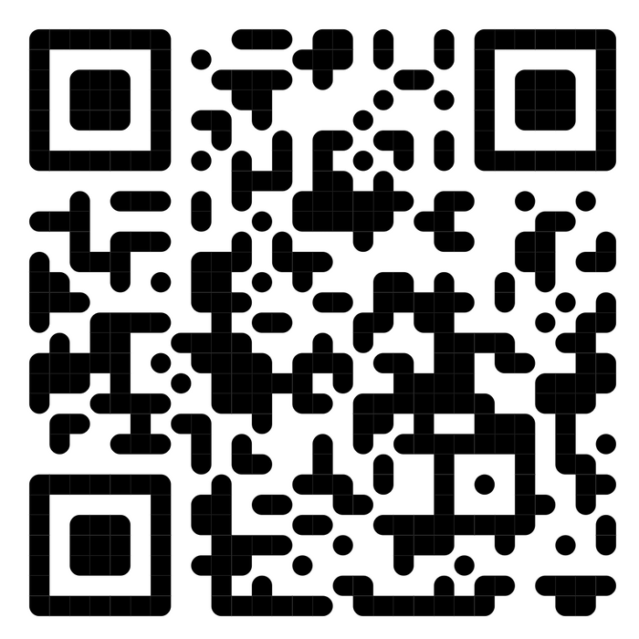
Scan the QR Code
Play and Enjoy!!!!!

Slide 15
CONCLUSION
The Color Stack Challenge project demonstrates how a simple game can be created using Python and the Pygame library. Through this project, we explored the basics of game development, including object-oriented programming, real time user input handling, animation, and game logic. By building this game, we gained hands-on experience with key concepts like the game loop, event handling, collision checking, and rendering graphics on the screen. The project also helped improve logical thinking, problem-solving, and code structuring skills. Overall, this project serves as a great foundation for beginners in game development and opens up possibilities for more advanced features and games in the future.

Slide 16
Thankyou

